Slide 1
POSIX Threads
執行緒、線程
Linux System Programming

Slide 2
Threads
Multiple strands of execution in a single program are called threads. A more precise definition is that a thread is a sequence of control within a process.
A single process can contain multiple threads, as illustrated in Figure 29-1. All of these threads are independently executing the same program, and they all share the same global memory, including the initialized data, uninitialized data, and heap segments.

Slide 3
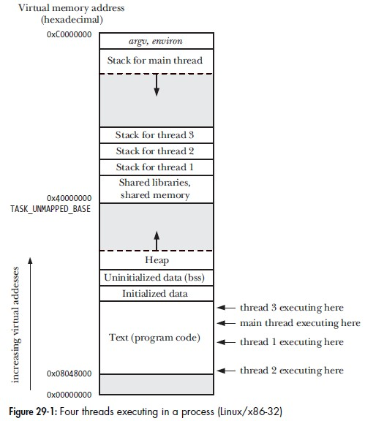
Threads

Slide 4
Pthreads API
#include <pthread.h>
int pthread_create(pthread_t *thread, pthread_attr_t *attr,
void*(*start_routine)(void *), void *arg);
Returns 0 on success, or a positive error number on error
void pthread_exit(void *retval);
int pthread_join(pthread_t th, void **thread_return);
gcc -D_REENTRANT -lpthread source.c
或
gcc -pthread source.c

Slide 5
Pthreads (1/2)
#include <unistd.h>
#include <stdio.h>
#include <stdlib.h>
#include <pthread.h>
void *threadA(void *arg);
int main(int argc, char *argv[])
{
int i;
pthread_t idA;
pthread_create(&idA, NULL, threadA, NULL);
for(i=0; i<5; i++){
printf("I am main thread\n");
sleep(2);
}
pthread_exit(NULL); //pthread_join(idA, NULL); exit(0);
}

Slide 6
Pthreads (2/2)
void * threadA(void *arg)
{
int i;
for(i=0; i<5; i++){
printf("\tI am threadA\n");
sleep(1);
}
printf("\tthreadA ends\n");
pthread_exit(NULL);
}

Slide 7
Exercise
試試看，讓 main thread 先結束，且不等待 child thread 結束，即不使用 pthread_join()。此時 child thread 是否會受影響 ?
若 main thread 結束時，不使用 exit()，而改用 pthread_exit()，結果有何不同 ?

Slide 8
Critical section (1/2) 臨界區段
#include <unistd.h>
#include <stdio.h>
#include <stdlib.h>
#include <pthread.h>
void *threadA(void *arg);
void *threadB(void *arg);
int value=1;
int main(int argc, char *argv[])
{
int i;
pthread_t thIDA, thIDB;
pthread_create(&thIDA, NULL, threadA, NULL);
pthread_create(&thIDB, NULL, threadB, NULL);
pthread_join(thIDA, NULL);
pthread_join(thIDB, NULL);
printf("final value = %d\n", value);
exit(0);
}

Slide 9
Critical section (2/2)
void *threadA(void *arg)
{
int i;
for(i=0; i<100000000; i++)
value++;
pthread_exit(NULL);
}
void *threadB(void *arg)
{
int i;
for(i=0; i<100000000; i++)
value--;
pthread_exit(NULL);
}

Slide 10
Mutex (mutual exclusion) 互斥锁
A mutex has two states: locked and unlocked. At any moment, at most one thread may hold the lock on a mutex. Attempting to lock a mutex that is already locked either blocks or fails with an error, depending on the method used to place the lock.
In general, we employ a different mutex for each shared resource (which may consist of multiple related variables), and each thread employs the following protocol for accessing a resource:
  lock the mutex for the shared resource;
  access the shared resource; and
  unlock the mutex.
Finally, note that mutex locking is advisory, rather than mandatory. By this, we mean that a thread is free to ignore the use of a mutex and simply access the corresponding shared variable(s). In order to safely handle shared variables, all threads must cooperate in their use of a mutex, abiding by the locking rules it enforces.

Slide 11
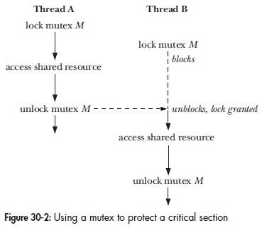
Mutex (mutual exclusion)

Slide 12
mutex API
#include <pthread.h>
pthread_mutex_t mutex = PTHREAD_MUTEX_INITIALIZER;
int pthread_mutex_destroy(pthread_mutex_t *mutex);
int pthread_mutex_lock(pthread_mutex_t *mutex));
int pthread_mutex_unlock(pthread_mutex_t *mutex);

Slide 13
mutex (1/2)
#include <unistd.h>
#include <stdio.h>
#include <stdlib.h>
#include <pthread.h>
void *threadA(void *arg);
void *threadB(void *arg);
int value = 1;
pthread_mutex_t mutex = PTHREAD_MUTEX_INITIALIZER;
int main(int argc, char *argv[])
{
int i;
pthread_t thIDA, thIDB;
pthread_create(&thIDA, NULL, threadA, NULL);
pthread_create(&thIDB, NULL, threadB, NULL);
pthread_join(thIDA, NULL);
pthread_join(thIDB, NULL);
pthread_mutex_destroy(&mutex);
printf("final value = %d\n", value);
exit(0);
}

Slide 14
mutex (2/2)
void *threadA(void *arg)
{
int i;
for(i=0; i<10000000; i++){
pthread_mutex_lock(&mutex);
value++;
pthread_mutex_unlock(&mutex);
}
pthread_exit(NULL);
}
void *threadB(void *arg)
{
int i;
for(i=0; i<10000000; i++){
pthread_mutex_lock(&mutex);
value--;
pthread_mutex_unlock(&mutex);
}
pthread_exit(NULL);
}

Slide 15
Exercise
Mutex 範例中，若用 pthread_mutex_lock() 與 pthread_mutex_unlock() 包圍整個 for() loop，有何不同 ?

